Slide 1

Usos y Costumbres del HoloLens
Sebastian Gambolati
Developer Sr.
Southworks

Slide 2
Workshop agenda
HoloLens presentation
Inside HoloLens
How to Develop
Exercise 1 – HoloWorld
Exercise 2 – Inputs
Exercise 3 – Spatial Mapping / Sound
Exercise 4 – Vuforia / Cognitive Services integration

Slide 3
HoloLens Presentation
DemoLens

Slide 4
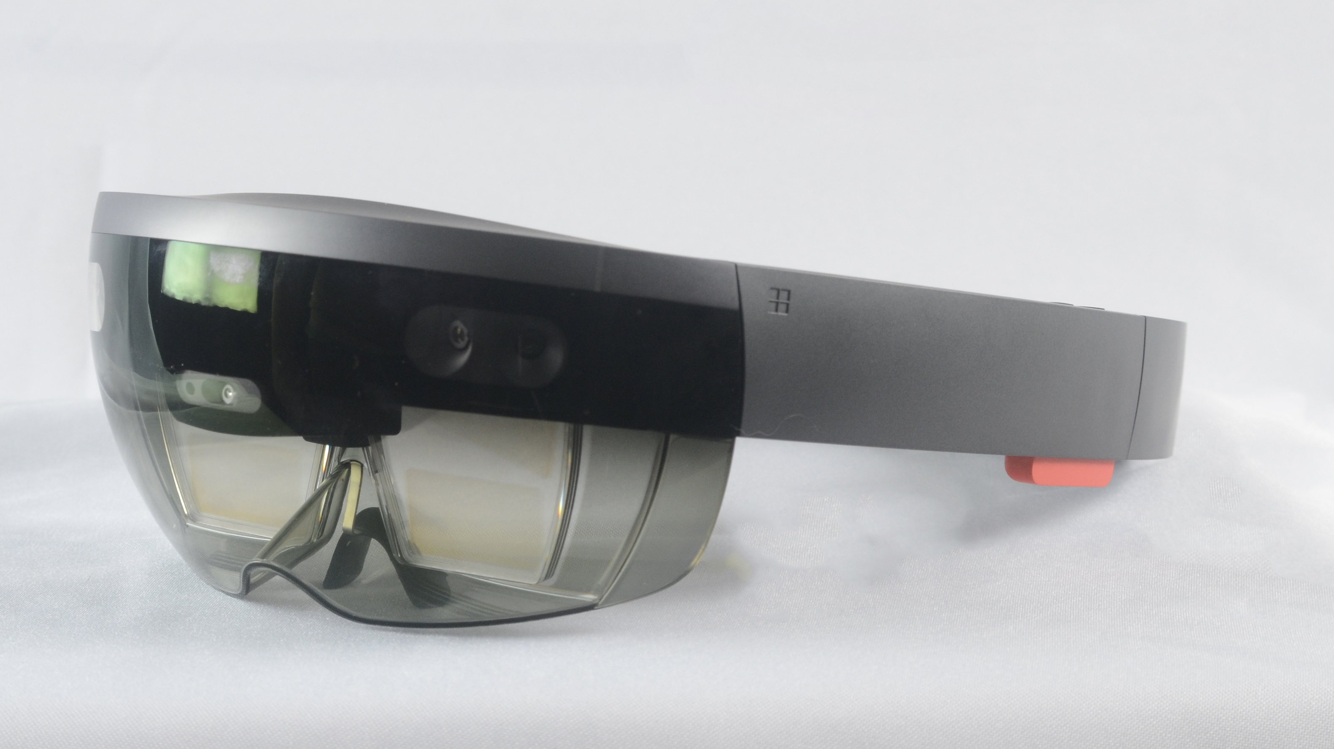
HoloLens Presentation
DemoLens

Slide 5
Real Reality
Virtual Reality
Augmented Reality
Mixed Reality
HTC Vive
Oculus Rift
Google Tango
AR Kit
HoloLens
Acer
HP

Slide 6
Prices comparison
Oculus Rift
U$D 598
HTC Vive
U$D 799
Google Tango: Lenovo Phab 2 Pro
U$D 500
ARKit: iPhone 7
U$D 769
Hololens
U$D 3000
Acer Mixed Reality Headset
U$D 299
HP Mixed Reality Headset
U$D 329

Slide 7
Inside HoloLens
Optics
Sensors
HoloLens has see-through holographic lenses
See-through holographic lenses (waveguides)
2 HD 16:9 light engines
Automatic pupillary distance calibration
Holographic Resolution: 2.3M total light points
Holographic Density: >2.5k radians (light points per radian)
HoloLens has sensors for environment understanding and human understanding
1 IMU
4 environment understanding cameras
1 depth camera
1 2MP photo / HD video camera
Mixed reality capture
4 microphones
1 ambient light sensor

Slide 8
Inside HoloLens (II)
Input / Output / Connectivity
Processors
Built-in speakers
Audio 3.5mm jack
Volume up/down
Brightness up/down
Power button
Battery status LEDs
Wi-Fi 802.11ac
Micro USB 2.0
Bluetooth 4.1 LE
The motherboard for Microsoft HoloLens
Intel 32 bit architecture with TPM 2.0 support
Custom-built Microsoft Holographic Processing Unit (HPU 1.0)

Slide 9
Inside HoloLens (III)
Power
Memory
Battery Life
2-3 hours of active use
Up to 2 weeks of standby time
Fully functional when charging
Passively cooled (no fans)
64GB Flash
2GB RAM
Weight
579g

Slide 10
How to Develop an HoloLens App
The MS way
Alternatives
Unity3D
HoloToolKit
Visual Studio 2015 (update 3) / 2017
HoloLens Emulator / HoloLens Device
UrhoSharp (by Xamarin)
Visual Studio + DirectX11

Slide 11
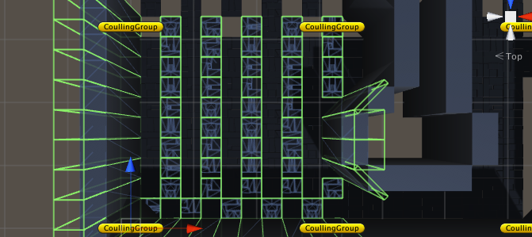
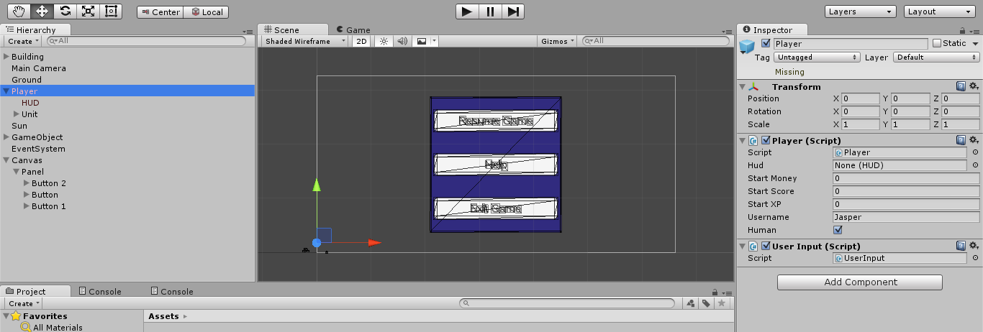
EXERCISES
Exercise 1: HoloWorld
Exercise 2: Input
Exercise 3: Spatials
Exercise 4.1: Vuforia
Exercise 4.2: Cognitive Services
https://github.com/sGambolati/HoloWorkShop
This Photo by Unknown Author is licensed under CC BY-SA
This Photo by Unknown Author is licensed under CC BY-SA

Slide 12
Exercise 1: HoloWorld
Briefing:
You will get your first Holographic App with a basic hologram.
Goals:
Get familiar with Unity3D.
GameObjects
Component
Prefab
Assets
Import HoloToolKit.
Generate Visual Studio project.
Deploy to HoloLens Device / Emulator.

Slide 13
Exercise 2: Input
Briefing:
You will get your hologram reaction to user interactions.
Goals:
Place a Gaze.
Handle User Air Tap.
Handle User Air Tap & Hold.
Handle Voice Action Input.
Play Text to Speech.

Slide 14
Exercise 3: Spatial Mapping / Sound
Briefing:
Your application will interact with the user environment.
Goals:
Map user room.
Query place where to place hologram into real world.
Add spatial sound to holograms.
Learn about UI elements
HeadIndicator
TagAlong
Billboard

Slide 15
Exercise 4: Vuforia / Cognitive Services Integration
Briefing:
Your application will use third party service to extend its behavior.
Goals:
Image recognition with Vuforia.
Object recognition with Vuforia.
Face recognition with Cognitive Services’ FaceAPI.
Query user context with Cognitive Services’ Computer Vision.

Slide 16
Thanks for your code!
Sebastian Gambolati
sebastian.gambolati@southworks.com
@sggambolati
http://dotgblog.wordpress.com

